Slide 1

Census Income Case Study
By Abdelrahman Ashraf Othman

Slide 2
Presentation Overview
Infographics
Recommendations
Predictive Model
About the Census Bureau

Slide 3
Overview of Dataset
this data about The United States Census Bureau (USCB), is a principal agency of the U.S responsible for producing data about the American people and economy. The Census Bureau's primary mission is conducting the U.S. Census every ten years, which allocates the seats of the U.S. House of Representatives to the states based on their population. The Bureau's various censuses and surveys help allocate over $675 billion in federal funds every year and it helps states, local communities, and businesses make informed decisions. The information provided by the census informs decisions on where to build and maintain schools, hospitals, transportation infrastructure, and police and fire departments.

Slide 4

About the Dataset

Slide 5
About Dataset
COLUMN | MEANING OF IT | DATA TYPE
Id | Unique identifier for Survey participant
Age | Age at time of participation
Work class | employment status
Education | education level of education
Education number | level of education
Marital status | Marital Status
Occupation | occupation
Relationship | relationship
Race | race
Gender | gender
Capital gain | profit one earns on the sale of an asset like stocks, bonds or real estate
Caoital loss | loss one incurs on the sale of an asset like stocks, bonds or real estate.
Hours per week | number of working hours per week
Native country | native country
Income | annual income(Label)
Income value | Actual income

Slide 6

Infographics& insights

Slide 7
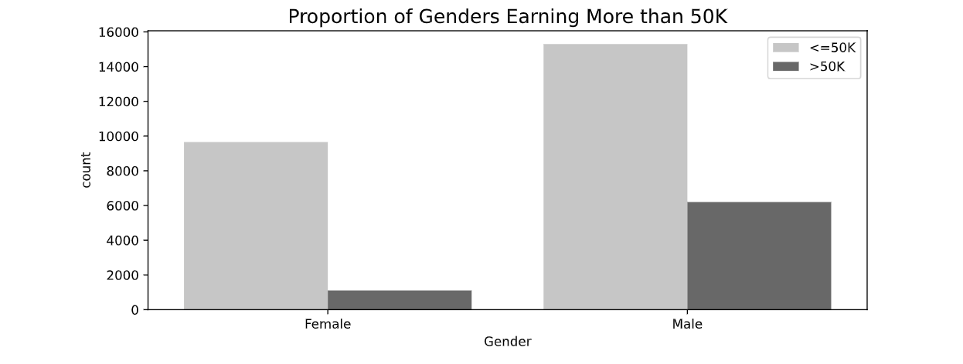
Insights and information
It seems that both genders are evenly matched when it comes to earning below 50K.
However, the vast majority of those earning above 50K are males

Slide 8
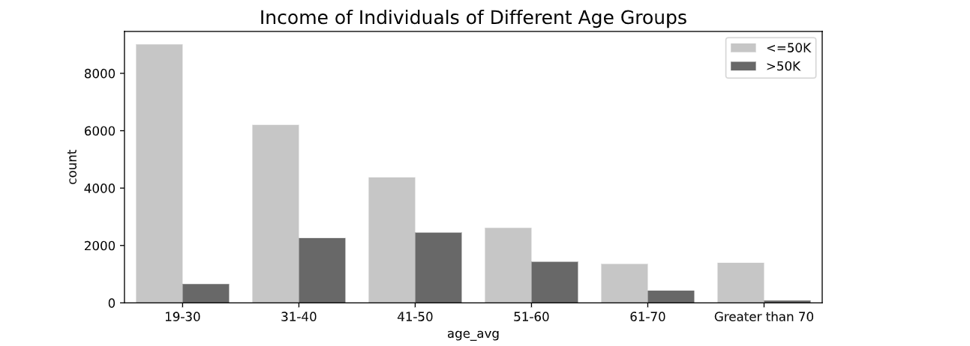
Insights and information
The number of people earning more than 50K is quite negligible amongst people of age group 19-30.
Individuals between the ages of 40 and 60 are more likely to earn above 50K
Individuals above 60 are less likely to earn above 50K presumably due to retirement

Slide 9
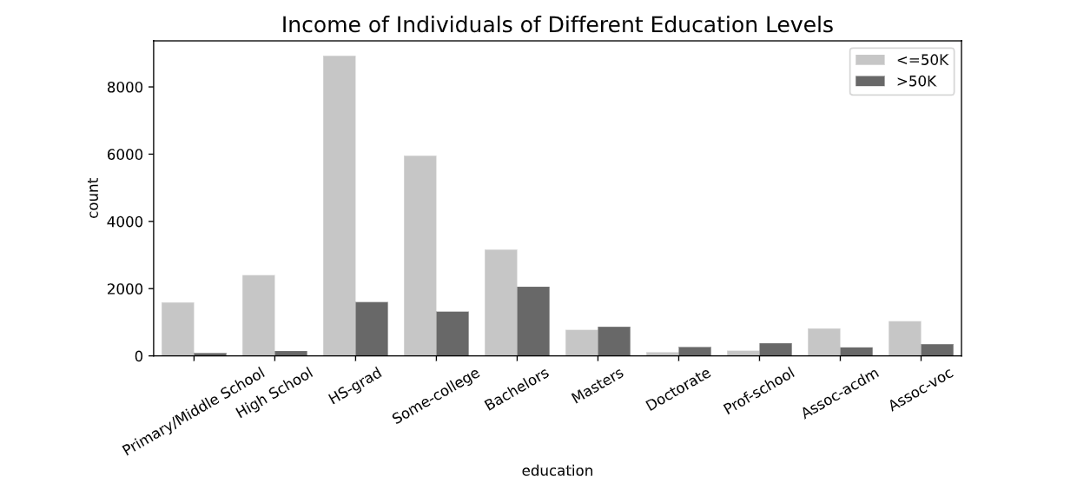
Insights and information
Oddly enough, Associates are less likely to earn above 50K, which could be explained by the academic field's less competitive salaries
There seems to be a correlation between education level and the probability of earning more than 50K, which ends after obtaining a master's degree

Slide 10
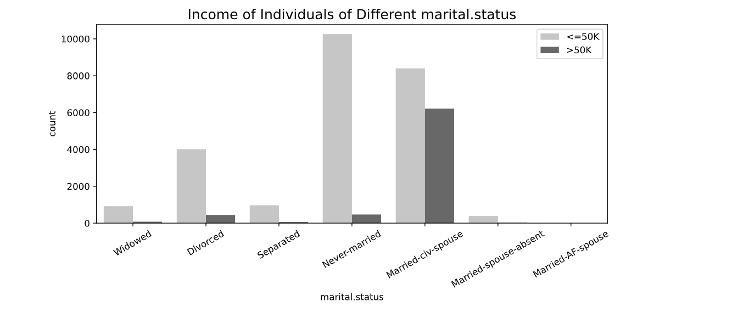
Insights and information
It seems that married people (to civilians) are the most likely to earn over 50K

Slide 11
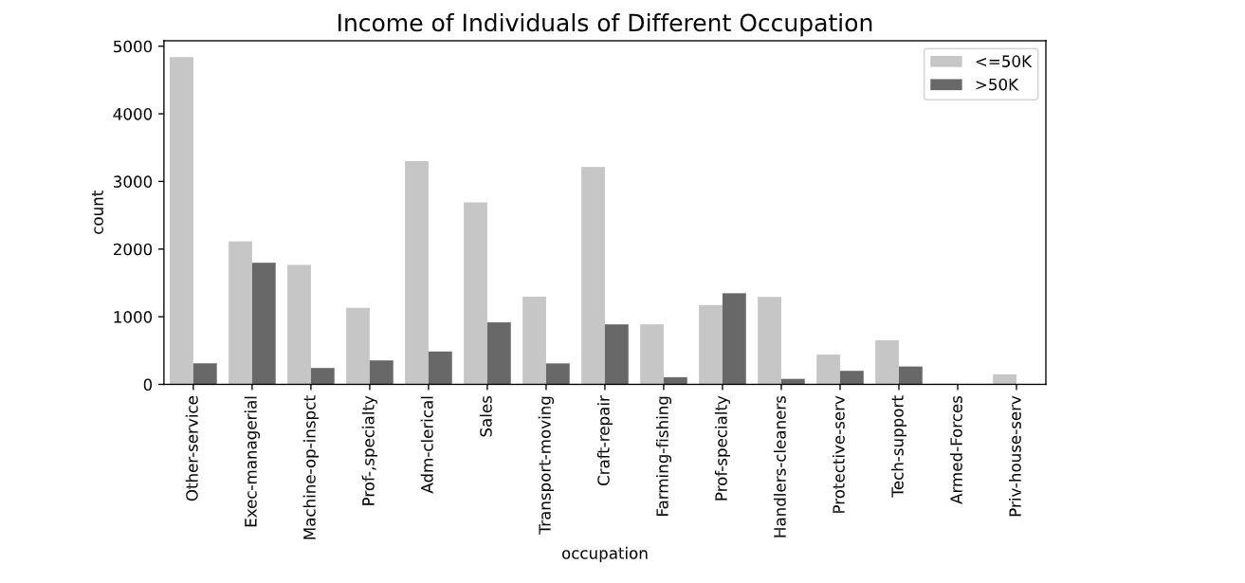
Insights and information
Prof- Specialty are more likely to earn more than 50K, although this contradicts the insights obtained from education level vs. income
A large segment of executives earn more than 50K

Slide 12
Main Insights
01
Male are more likely to earn >50
Earning more than 50K
02
Positive correlation between income and education level until master degree
03
Married individuals are more likely to earn more

Slide 13
Recommendations
Providing individuals’ area zip codes would facilitate segmentation of low-income areas and ensure that assistance can be provided.
Income range ought to have more than two categories since it is rather challenging to base decisions on limited data.
Income values are mostly missing which is not conductive to building an accurate predictive model nor will it aid when attempting to allocate funding accordingly.

Slide 14

Predictive Model

Slide 15
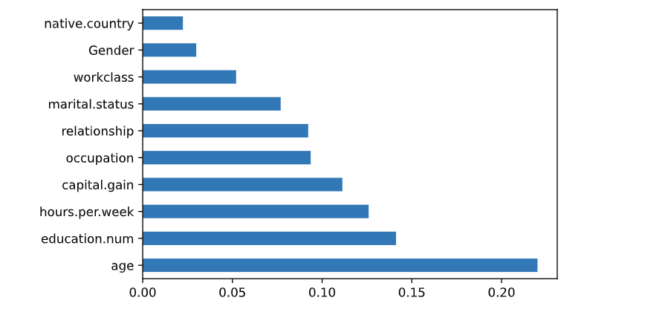
Feature Selection
This supports the relationship between income category and age
Hours per week and education years present an important aspect when it comes to predicting income category

Slide 16
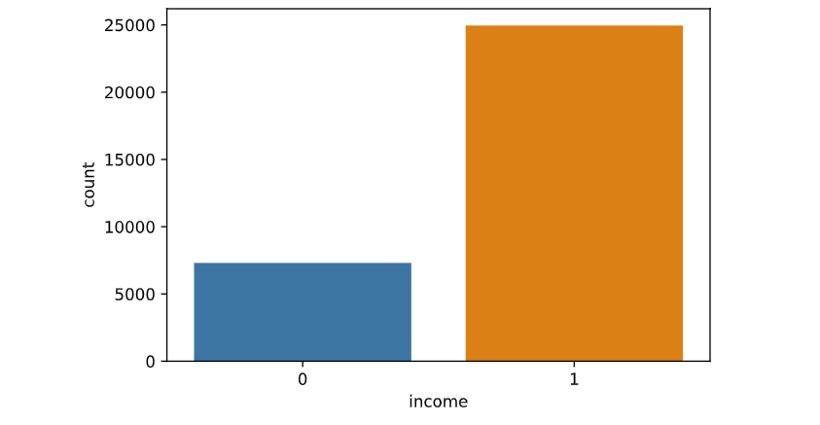
Solving the unbalancing Dataset
As we see this data set is unbalanced by ratio of 70% for (<=50) and 30% for (>50).
So, I used SMOTEENN function to solve it.

Slide 17
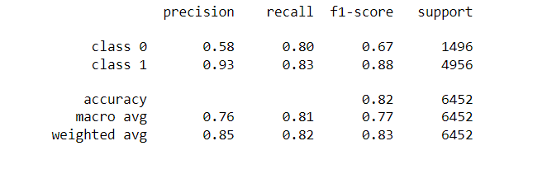
The Model
I used XG-Boost Model because we have an outlier at some columns, and this model is worked with it without any problem at the output.
The accuracy and confusion matrix of the model:

Slide 18
‏"THE IDLE MIND IS THE DEVIL'S WORKSHOP WHEN YOU LOSE FOCUS, YOUR MIND TENDS TO FIX ON WHAT COULD BE WRONG WITH YOUR LIFE INSTEAD OF WHAT'S RIGHT"
- Cal Newport

Slide 19
THANK YOU

